Slide 1
CHAPTER 4 NEURAL NETWORKS

Slide 2
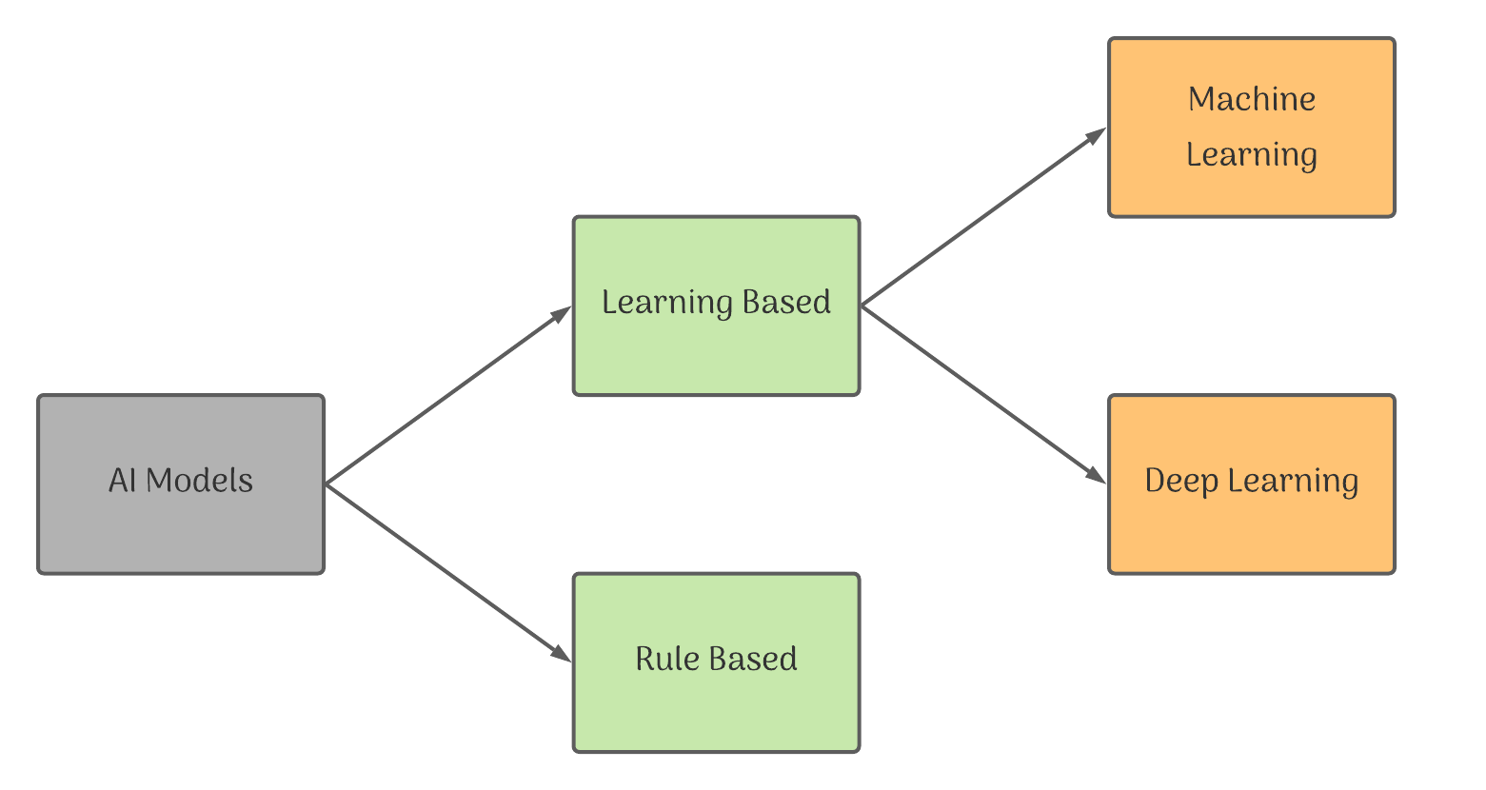
Modelling

Slide 3
Rule Base learning
Rule based approach, the developer feeds in data along with some ground rules to the model. The model gets trained with these inputs and gives out answers in the form of predictions. This approach is commonly used when we have a known dataset or labelled dataset.

Slide 4
Machine learning
Machine Learning approach the developer feeds in data along with the answers. The machine then designs its own algorithms and methodologies to match the data with answers and gives out the rules. This approach is commonly used when the data is unknown/random or unlabelled.

Slide 5
Common AI models Are
Regression
Classification
Clustering

Slide 6
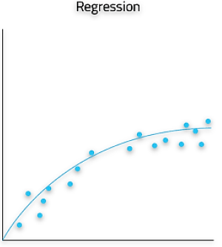
REGRESSION:
This is a type of Rule based AI model.
In regression, the algorithm generates a mapping function from the given data, represented by the solid line.
The blue dots shown in the graph are the data values and the solid line here represents the mapping done for them. With the help of this mapping function, we can predict the future data.
For example, if we want to predict the salary of an employee, we can use his past salaries as training data and can predict his next salary.
Regression works with continuous data.

Slide 7
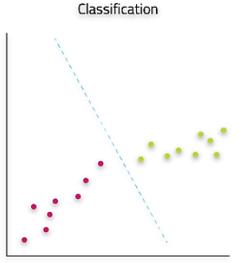
Classification -
This is a rule based AI model
In classification, the algorithm is able to determine which set a given data point belongs to by means of a classification function represented by the dotted line.
The model classifies datasets according to the rules given to it.
Usually the dataset used for classification are labelled and the data then gets sorted according to their labelling.
Testing data is then classified as one of the labels of the training dataset.
For example, If we want to train a model to identify if an image is of a guitar or a piano, we need to train it with multiple images of both guitar and piano along with their labels. The machine will then classify images on the basis of the labels and predict the correct label for testing data. Classification works on discrete dataset..

Slide 8
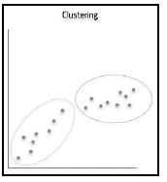
CLUSTERING:
This is a Machine learning approach where the machine generates its own rules or algorithms to differentiate amongst the given dataset to achieve the pre-decided goal.
The data fed to such a model is usually unlabelled or random and thus the developer feeds in the data directly into the machine and instructs it to build its own algorithm.
The machine then finds out patterns or trends out of the training dataset and clusters the ones which follow the same pattern.
The output rules might be very different to what was expected as the machine has its own way of recognising patterns.
For example, if you have a random data of stray dogs which live in your locality, since you are unable to find any meaningful pattern amongst them, you would feed their data into the clustering algorithm.
The algorithm would then analyse the data and divide them into clusters according to their similarities based on the trends noticed. The clusters are then given as the output.
Clustering works on discrete dataset.

Slide 9
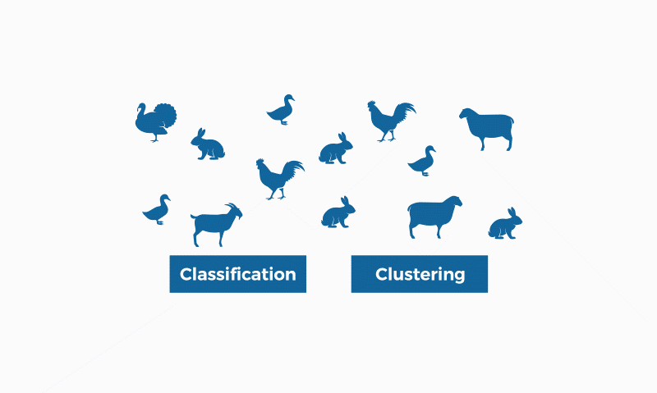

Slide 10
Neural Networks-Definition
Neural networks are loosely modelled after how neurons in the human brain behave. The key advantage of neural networks are that they are able to extract data features automatically without needing the input of the programmer.
A neural network is essentially a system of organizing machine learning algorithms to perform certain tasks. It is a fast and efficient way to solve problems for which the dataset is very large, such as in images.

Slide 11
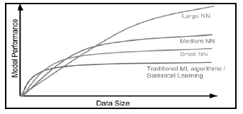
As seen in the figure given, the larger Neural Networks tend to perform better with larger amounts of data whereas the traditional machine learning algorithms stop improving after a certain saturation point.

Slide 12
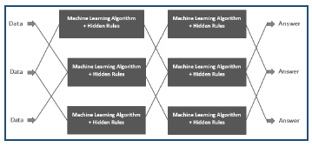
Neural Network structure

Slide 13
This is a representation of how neural networks work. A Neural Network is divided into multiple layers and each layer is further divided into several blocks called nodes.
Each node has its own task to accomplish which is then passed to the next layer.
The first layer of a Neural Network is known as the input layer. The job of an input layer is to acquire data and feed it to the Neural Network. No processing occurs at the input layer.
Next to it, are the hidden layers. Hidden layers are the layers in which the whole processing occurs. Their name essentially means that these layers are hidden and are not visible to the user. Each node of these hidden layers has its own machine learning algorithm which it executes on the data received from the input layer.
The processed output is then fed to the subsequent hidden layer of the network.
There can be multiple hidden layers in a neural network system and their number depends upon the complexity of the function for which the network has been configured. Also, the number of nodes in each layer can vary accordingly.
The last hidden layer passes the final processed data to the output layer which then gives it to the user as the final output.
Similar to the input layer, output layer too does not process the data which it acquires. It is meant for user-interface.

Slide 14
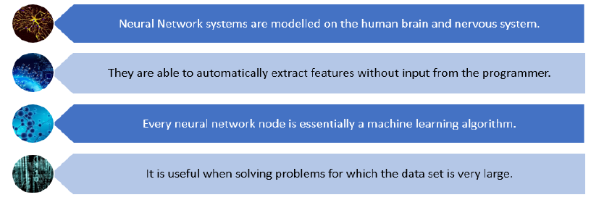
Neural network features

Slide 15
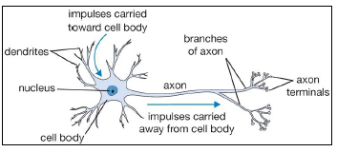
Neural Networks Vs Human Nervous System

Slide 16
Neural Networks Vs Human Nervous System
Given are the images of a Human Neuron and its relation with the Neural Network.
The axon from a neuron sends an impulse to the synapse of another neuron.
The impulse received is then sent to the cell body (nucleus) through dendrites.
The cell body performs an activation function on the impulse received and then gives it to the output axon which passes the same to the next neuron in the system.
Now as we relate this process with an Artificial Neural Network, we can see that the input layer gets data which is passes on to the nodes in the hidden layer. The nodes perform specific actions on the data and pass the processed information to the next layer. In the end, the final processed data reaches the output of the system.

Slide 17
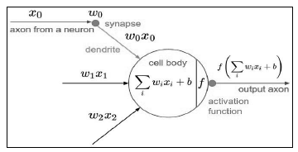
Neural Networks Vs Human Nervous System

